Slide 2
Angular Pipes
An introduction, a guide to each pipe, then a look into the internals, and finally some asynchronous stuff

Slide 3

What is a pipe?
A class which is preceded by the @Pipe{} decorator and which defines a function that transforms input values to output values for display in a view.

Slide 4


Slide 5
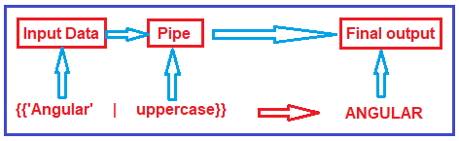

Slide 6
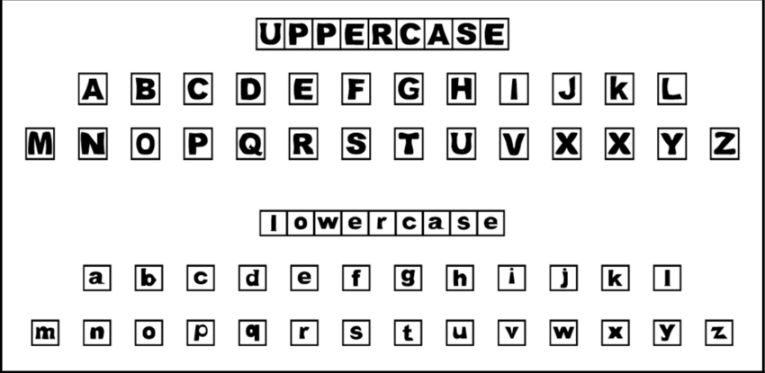
Uppercase, lowercase & titlecase
Pipes for modifying the text we are working with. This pipes have no arguments, and each of them do the following.
Uppercase: Converts a input string to all UPPERCASE letters.
Lowercase: Converts input string to all lowercase letters.
Titlecase: Capitalizes the first letter of each word, makes every other letter lowercase.

Slide 7
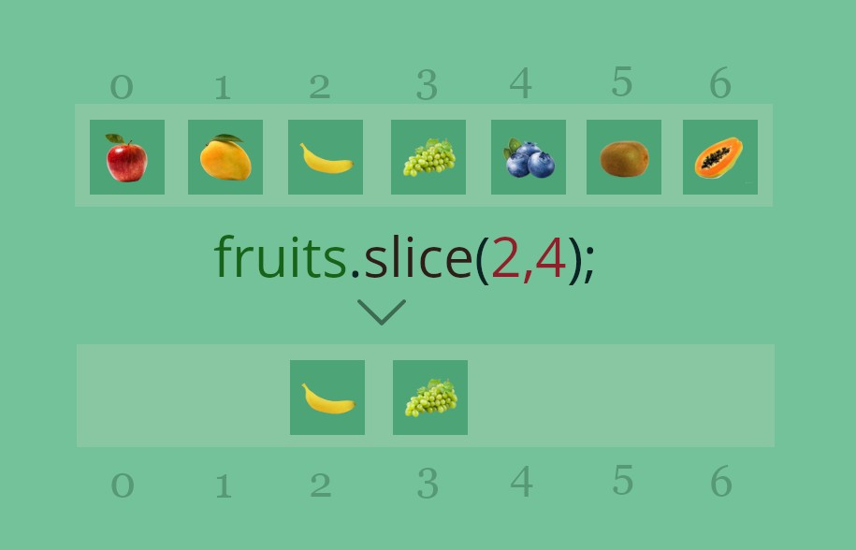
Slice Pipe
This pipe has the same behavior as the slice method in JavaScript, and as in JS, it applies to both strings and arrays. This pipe needs a 'start' parameter, but it also accepts an optional 'end' parameter.

Slide 8
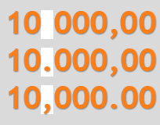
Decimal Pipe
This pipe is used to format numbers, it can receive either numbers or strings that can be transformed into numbers. Contains 2 optional parameters, 'digitsInfo' tells you how the number is going to be formatted, 'locale' determines parameters such as group sizing, separator, decimal point character and such on.

Slide 9
Percent Pipe
Functionally the same as the decimal pipe, with the exception that it handles numbers as percentages.

Slide 10
Currency pipe
Similar to the decimal pipe, it is used to format values representing money. Aside from the 'locale' and 'digitsInfo' parameters, it also lets you choose currency based on the ISO 4217, as well as the representation of said currency.

Slide 11
Date pipe
This pipe allows us to format a number, string or Date object into a variety of formats, giving us an easy way to print out dates exactly the way we want. The parameters this pipe provides (all optional) are 'format', 'timezone', and 'locale'

Slide 12

JSON Pipe
This pipe receives any type of input, it then applies the JSON-format string transformation, allowing the display of JSON objects.

Slide 13
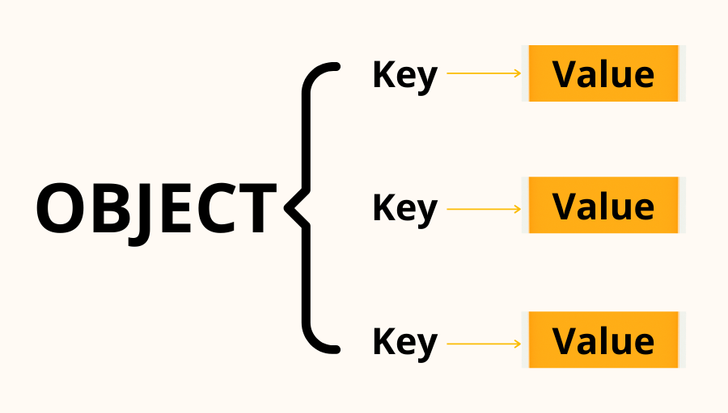
Key Value Pipe
Transforms an object into an array of key-value pairs. Takes an optional parameter which specify the order in which these pairs will be ordered.

Slide 14

I18nSelectPipe
Internationalization pipe. It takes a string as input, afterwards it takes an object specifying the output for the given input string

Slide 15
I18nPluralPipe
Also used for internationalization, this pipe receives a number as input, then uses a map as a parameter to determine the correct message. It also takes an optional parameter for different results depending on the 'locale'.

Slide 16

Async Pipe
The async pipe is used to handle asynchronous operations, such as promises and observables. Unlike the subscribe method, the unsubscribe logic is automatically handled once the component is destroyed.

Slide 17
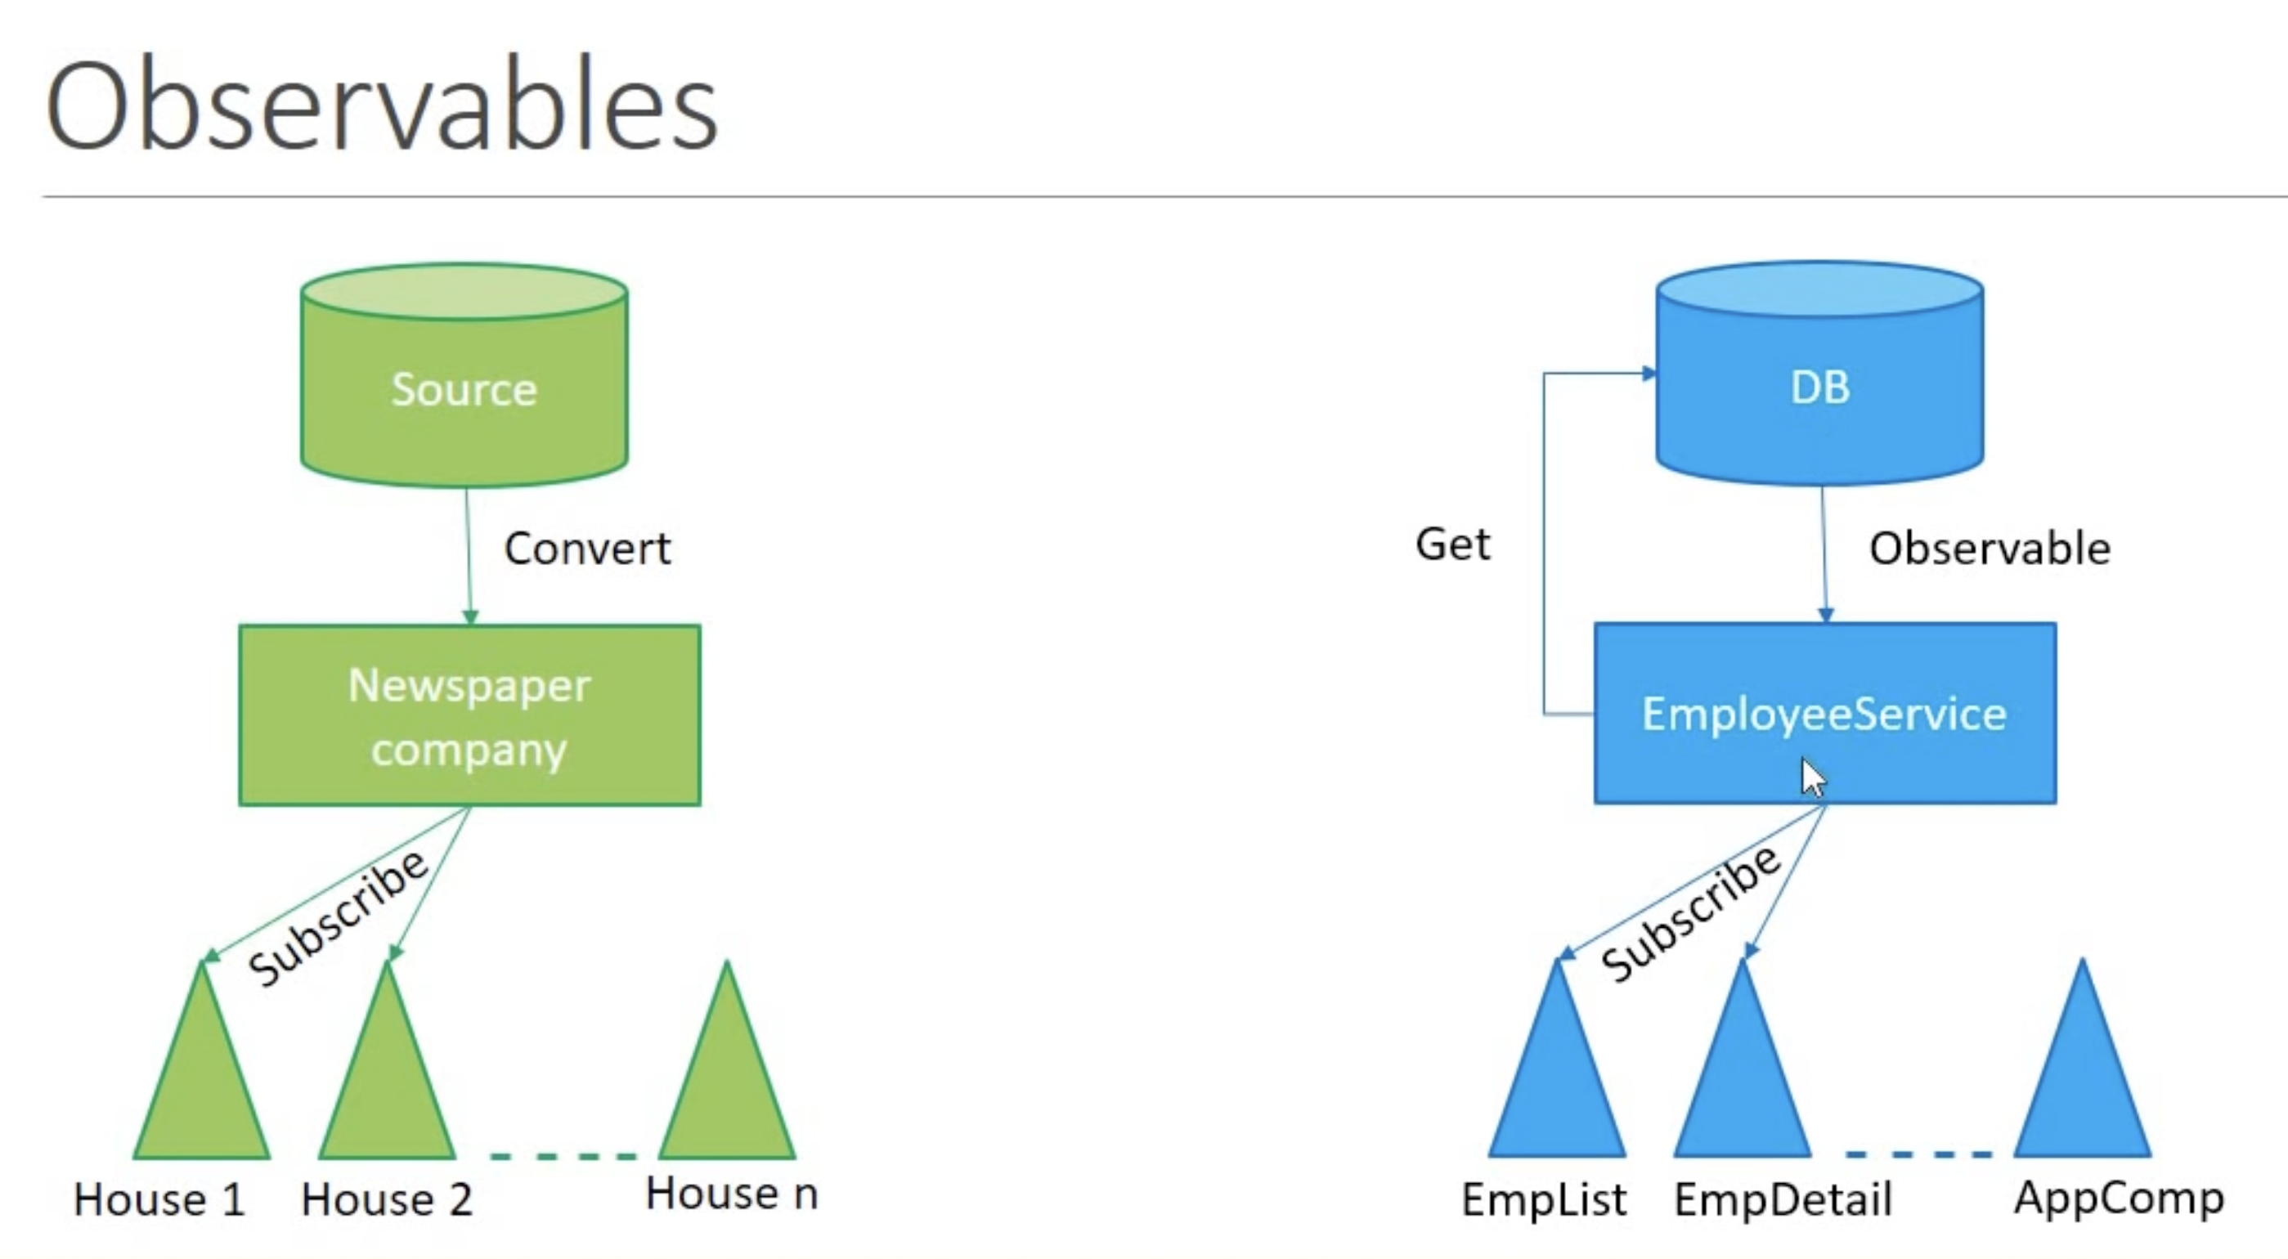

Slide 18
Custom Pipes
We can also generate our own custom pipes. We can easily create them using the 'ng g p <pipe_file_path>' command using the CLI. We can define the value the pipe should receive, which and how many arguments it should expect, as well as the result type.

Slide 19

Pures vs Impure pipes
Angular checks for changes any time an event is triggered. If it were to check each element after every update, this would hurt performance greatly, therefore Angular only checks and updates elements when the primitive input value or the object reference changes. This is known as 'Pure' changes.
Pipes are pure by default, but we can disable this behavior, transforming them into 'impure pipes'.

